Slide 1
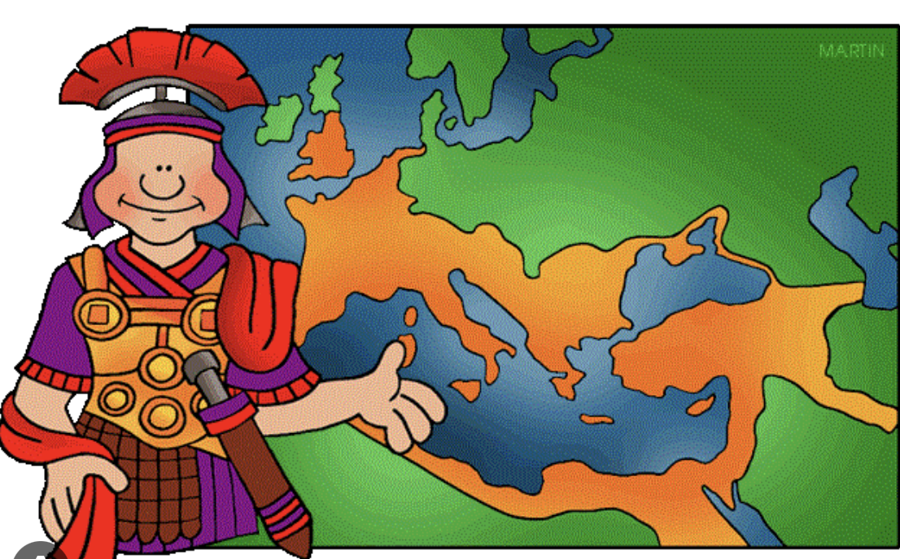
Romans in Britain
English
Review and recap
Reading (guided and individual – linked to history and science).
Spellings
Diary Entry
Life of a Roman Soldier
Science – Children will learn about light sources that are natural and artificial. They will investigate the sun and how it can be harmful. They will look at reflection and refraction and create a shadow experiment.
Music
Musical Notes
What are musical notes
What sound do they make on an instrument
Maths
Length and Perimeter
Fractions
Mass and capacity
PE
Working through the Real PE curriculum
Team building exercises.
Computing
Planning and creating branching databases.
Safety – online reputation.
Learn together
Focus this term:
Healthy me
What is safe
What is unsafe
Belief Systems
Term 4
History
Timeline of the Roman Empire.
Reasons for invading Britain.
Contributions to British life.
Resistance to Roman rule.
The impact of Roman withdrawal from Britain.
DT:
What are linkages and levers?
Designing and making an Easter card with linkages and levers.

Slide 2
Key words
English
Diary
Perfect Verb
Preposition
Adverb
Feelings and thoughts
Expanded Noun Phrase
Science – Light:
Light
Beam
Shadow
Refract
Spectrum
Rays
Reflect
Filter
Music
Reggae
Gamelan
Samba
Polyrhythms
Percussion
Mariachi
PE
Team
Acceptance
Empathy
Maths
Numerator
Denominator
Unit, non-unit, whole
Compare
Equivalent
Computing
Data
Grouping
Data Collection
Database
Learn together:
Drugs
Health
Fitness
Calories
Harmful
Belief Systems - Islam
Term 4
History:
Timeline
Invasion
Empire
Revolt
Boudicca
DT:
Mechanism
Linkage
Lever
pivot

