Slide 1
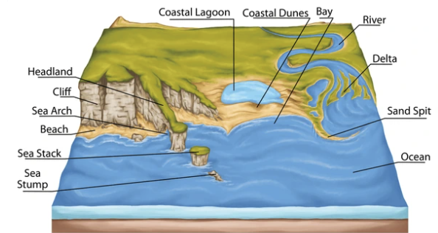
Coastal Characteristics.
English
Review and recap
Reading (guided and individual – linked to science and geography topics).
Spellings
digraph ‘ei’ and tetragraph ‘eigh’, digraph ‘ey making an ‘ai; sound, homophones, challenge words, words ending in –al, words ending in –le.
Science – Fossils and soil.
What is a fossil?
How is a fossil formed?
Exploring different types of soil.
Why is soil important?
Experimenting the absorbency of soils.
Music
Music around the world.
Listening to and appraising music from: Jamaica, Indonesia, Brazil, Mexico, The Czech Republic, China,
PE
Working through the Real PE curriculum
Team building exercises.
Maths
Year 3
Reasoning and problem solving.
Multiply by 10
Link multiplication and division
Length and Perimeter
Add lengths
Subtract lengths
Meter, centimeter and millimeter
Computing
Using Scratch for programming, coding and making sequences.
Term 3
DT:
Research the structure of a bird nest. Look at different birds and where they build their nests... and why? Plan and build your own nest that is structurally able to hold an egg.
Geography
Coastal Characteristics.
Understand what a coast is
Identify different coasts
Explore coastal features
Human impact on coasts
Coastal wildlife
Learn together
Focus this term: Dreams and Goals
Belief Systems

Slide 2
Key words
English
Float
Boat
Preposition
Adverb
Feelings
Expanded Noun Phrase
Science – Fossils and soil
Fossil
Rock
Skeleton
Shell
fossilisation
Sediment
Soil
Organic matter
Nutrients
Deforestation
Habitat
Music
Reggae
Gamelan
Samba
Polyrhythms
Percussion
Mariachi
PE
Team
Acceptance
Empathy
Maths
Estimate, Inverse, Digits, Strategy, Problem solving, Reasoning, Commutative, Multiply, Divide, millimeter, centimeter, meter, length, equivalent, perimeter
Computing
Sprites
Backdrops
Commands
Program
Coding
Sequence
Learn together:
Keep trying
Positive attitude
Working with others
Help others achieve their goals
Belief Systems - Islam
DT:
Nest, materials, predator, insulation, birds, structure
Term 3
Geography:
coastline current
beach tide
cliff lighthouse
shore
erosion
weathering

