Slide 1
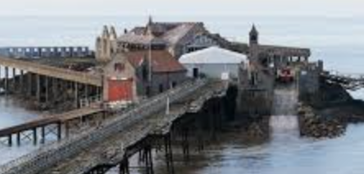
Weston’s Wonderful Piers
English
Review and recap
Reading (guided and individual – linked to science and history topics).
The Iron Man
A narrative based on rags to riches.
A debate on whether the Iron Man should be thrown into the pit or not
Spellings
Prefix –mis, words ending in –ing, -er, -ed and –en in multisyllabic words, challenge words, digraph ‘ai’ and tetragraph ‘eigh’, digraph ‘ey making an ‘ai; sound.
Science –
Finish Nutrition Topic
Look at food waste and the impact on the environment
Rocks: Look at and study different types of rocks
Use experiments to identify each unique quality
What does the weather do to rocks?
Music
Following rhythms and reading musical notation.
Using musical notation to create own rhythms.
Observing changes in dynamics and tempo.
PE
Working through the Real PE curriculum (dynamic and static balances).
Team building exercises.
Computing
Use a range of techniques to create a stop-frame animation.
Create a story-based animation with music and text.
Maths
Year 3
Addition and subtraction with 3-digit numbers using formal written methods.
Multiplication and division.
Reasoning and problem solving.
Term 2
History
Weston’s Wonderful Piers.
Local history.
Chronology of local landmarks in the context of wider history.
Sources exploration.
MFL- Spanish
Find Spain on a map.
Use key greetings and ask questions.
Count to 10 in Spanish.
Read, write, say and recognize colours.
Learn together
Focus this term: Peace and kindness
Includes:

Slide 2
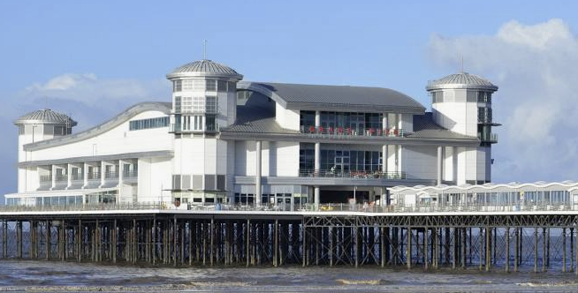
Key words
English
Stormy
Giant
Colossal
Menacing
Courage
Curious
Transform
Science – Rocks
Granite
Pumice
Marble
Brittle
Reaction
Texture
Weathering
Music
Rhythm
Tempo
Dynamics
Compose
PE
Dynamic balance
Static balance
Combination
Quarter turn
Half turn
Maths
Estimate, Addition , Subtraction, Inverse, Digits, Strategy, Problem solving, Reasoning, Commutative, Multiply, Divide
Computing
Animation, text, images, landscape, portrait, layout, content, frame, sequence, media, delete, programming, motion.
Learn together
Family
Conflict
Bullying
Resolution
Kindness
Words
Helping
Term 2
History
Chronology
Decade
Century
Revolution
Landmark
Source
MFL- Spanish
Hola, iBuenos dias! Estoy bien, Estoy mal, iAdios! Uno, dos, tres, cuatro, cinco.

