Slide 1
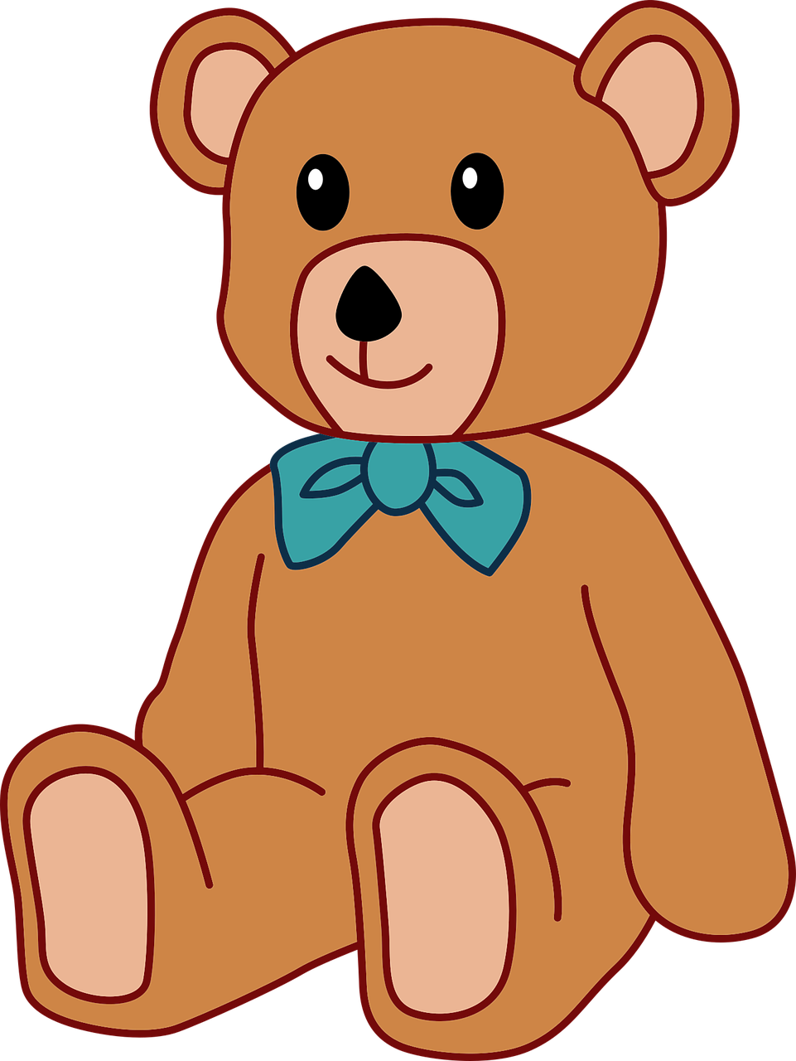
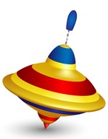
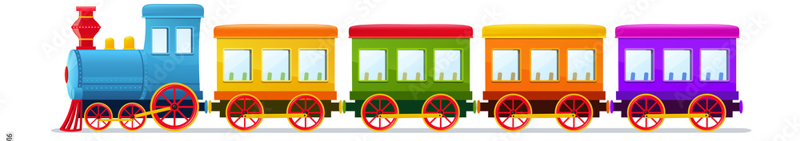
Literacy
As writers we will be exploring the text Lost in the Toy Museum where we will be writing descirptions of a missing toy as well as inventing our own toys and labelling them.
In phonics the children will be continuting learning new sounds, writing words usin these sounds and reading words independently.
Personal, Social and Emotional Development
We will work on:
Recognising and discussing our feelings
Discussing how to be a good friend
Helping people in need
Taking turns and sharing
Dealing with conflicts
Maths
As Mathematicians we will be learning about Alive in 5, focusing on making, forming and gaining a deeper understanding of numbers to 5.
We will have lessons as well as offering experinces within the environment.
We will be singing lots of nursery rhymes and will have counting as part of our daily routine.
Spring 1
Toy Time Travelers
Understanding of the World
We will develop our skills by.....
Looking at toys from histroy
Comparing modern and older toys
Looking at the mateiral toys are made from
Inventing toys
Looking at toys and games around the world
Communication and Language
As communicators, we will be developing our speaking and listening skills. Children will be retelling stories, offering opinions and sharing facts as well as answering questions about what we have read. We will be focusing on what makes a question.
Expressive Arts and Design
As Artists we will be:
Singing familiar songs
Moving rhymically
Exploring sounds and instruments
Drawing and painting
Exploring a range of mark making tools
Exploring the role play and small world areas to ignite our imagination.
Physical Development
To develop our skills we will...
Practise writing our names
Play finger strength games such as dough disco
Use RWI mnemonics to support letter formation
Use using cutlery with independence
Find different ways to move
Look at how exercise effects our body
Practise how to use a range of tools effectively and safely such as scissors.
Write independently during continuous provision
Learn Together
The Learn Together theme we are looking at is Exploring the Natural World and the focus Strand is An Ethical Aproach to the Environment.

Slide 2

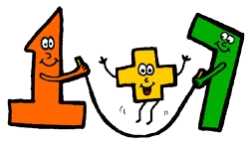


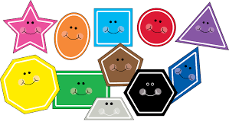


Literacy
Description
Clues
Adjectives
Museum
Histroy
Modern
Past
Present
Traditional
Country
Clockwork
Electric
Push
Pull
Wind up
Motor
Vocabulary
Spring 1
Maths
Subitise
More and Less
How many?
On top
Under
In front
Behind
Next to
Circle
Square
Triangle
Rectangle
Pentagon
Cube
Sphere
Cuboid
Pyramid
Build and Construct
Left
Right
Forwards
Backwards
Topic words
Comforted Man-made Factory
Special Natural Batteries
Tradition Cotton Pulley
Remote control Metal Stationary
Fabric Plastic Speaker

