Slide 1
At Educate Together schools, school uniform is not worn; we prefer to allow children and their parents/carers to choose what they wear to school, encouraging individuality, personal taste and style. However, we expect children to be dressed sensibly and practically, ready to enjoy a busy day at school. Pupils must be dressed ready for practical, physical and sometimes messy activities, and in clothing and footwear that they can manage independently and move about safely in. A Parklands School sweatshirt is available if required, and can be purchased from NK Sports, in Worle:
https://www.nkgroupuk.com/collections/parklands-et-primary
Our dress code:
Clothing must be reasonably modest.
Underwear should not be visible.
Clothing that is controversial or degrades any culture, gender, religion or ethnic values is not acceptable.
All parts of the stomach and back must be fully covered without pulling or tugging, e.g. no crop tops
Tops must be long enough and loose enough to be tucked into leggings/jogging bottoms for PE.
Spaghetti straps, strapless tops, muscle shirts, off-shoulder shirts and tank tops are not allowed.
Try to avoid clothing that may be distracting to learning (ie. flashing shoes, feely jumpers etc.).
Pyjamas are only allowed on dedicated 'pyjama days’ ‘pyjama parties’.
Fancy dress clothes are only allowed on dedicated days e.g. events such as Children in Need or a class party.
Slogans/images/logos or any written text on clothing must not contain vulgar, obscene words or graphics.
Footwear should be the correct size and cover the foot to ensure that the child can take part in all aspects of school life safely, e.g. no heels, no crocs or other like brands, flip flops, back straps, backless shoes, open sandals, platform shoes, or shoes with wheels.
Watches, small stud earrings or religious items required by the child's faith may be worn; no other jewellery items are allowed.
Smart watches with camera facilities and independent access to the internet must not be worn.
Hats and scarfs must not be worn inside unless children are required to wear these for religious reasons.
Sunhats and sunglasses are encouraged to be worn during recreational times in the summer months.
Appropriate winter wear should be worn during the winter months, e.g. winter coats, hats, scarves and gloves.
Wellington boots may be worn to school, but children must have and alternative to change into once in school.
PE days
On PE Days children should wear a loose-fitting top and shorts/leggings/jogging bottoms which allow children full movement of their bodies.
Children should also wear suitable footwear such as trainers.
Ear studs should be removed or covered with medical tape for health and safety purposes.

Slide 2
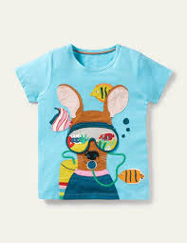
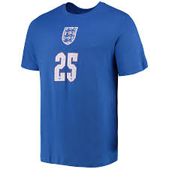
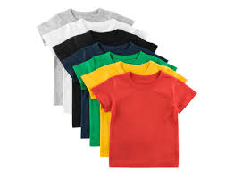
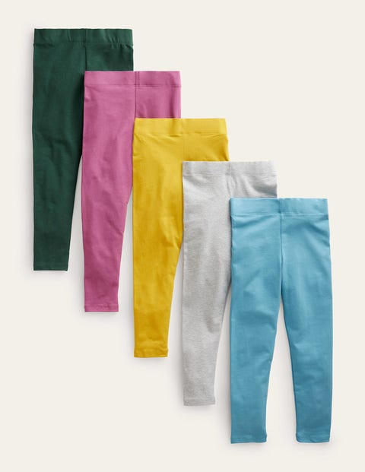
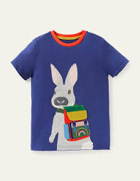
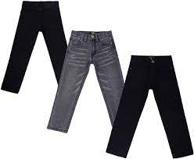
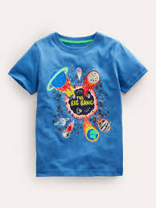
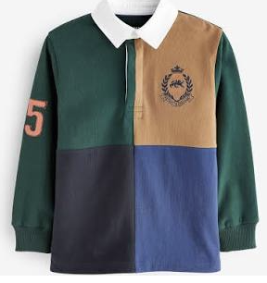
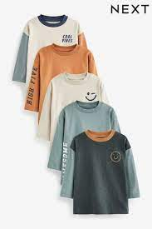
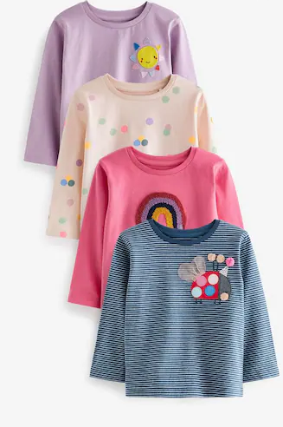
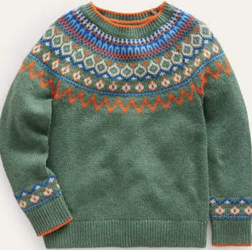
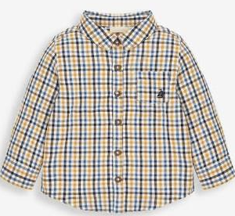
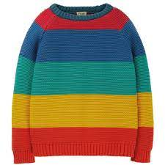
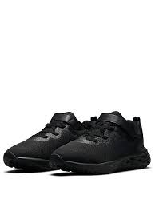
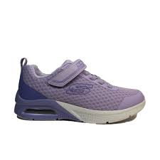
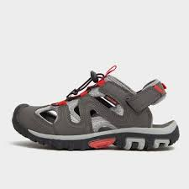
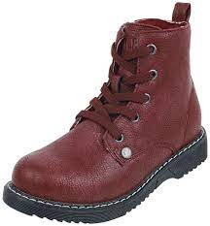
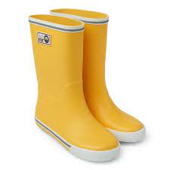
What can be worn:
On the bottom:
On the top:
Leggings
jeans
Tshirts
Think: can they move with ease in these?
shorts
Skirts and dresses
Long sleeved tops
Jumpers
Think: just above the knees please
Shoes
Think:
Positive messages
No distraction
Comfort and cover
Think: comfort, grip and not slipping off

